Slide 1
SHREE SIDDHESHWAR WOMEN’S COLLEGE OF ENGINEERING, SOLAPUR
Cafe Ordering System
PRESENTED BY:
Pranali Sandupatla
Jaya Mergu
Nandini Saka
GUIDED BY:
Prof. P. V. Kale

Slide 2
INTRODUCTION
The Cafe Ordering System is a cutting-edge solution designed to revolutionize the way customers interact with cafes. This system simplifies the ordering process, providing an intuitive and engaging interface for customers, while offering powerful management tools for administrators.
In the fast-paced environment of modern cafes, efficiency and customer satisfaction are paramount. The Cafe Ordering System is a critical tool designed to address the challenges faced by both customers and cafe operators. By leveraging technology, this system enhances the ordering process, improves operational efficiency, and ultimately contributes to a better customer experience.

Slide 3
NEED AND IMPORTANCE
Need for the Cafe Ordering System:
1.Streamlined Ordering Process
2.Enhanced Customer Experience:
3.Efficient Payment Processing
4.Inventory Management:
Importance of the Cafe Ordering System:
1.Operational Efficiency:
2.Data Management and Analytics:
3.Enhanced Communication:
4.Scalability and Flexibility:
5.Cost Savings:

Slide 4
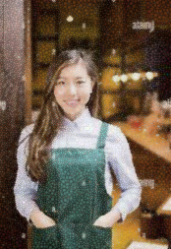
CURRENT SYSTEM
In the current system, a cafe's ordering process might be manual or use a basic software application. The existing system often involves:
Manual Order Taking: Wait staff manually takes orders using pen and paper.
Basic POS System: Simple Point of Sale (POS) systems where orders are entered into a basic computer system but with limited features.
Limitations Prone to Errors: Manual entry can lead to errors.
Inefficient: Time-consuming for both staff and customers.
Limited Reporting: Basic systems may not provide detailed sales reports or analytics.
No Integration: Often lacks integration with other systems like inventory management, online ordering, or customer loyalty programs.

Slide 5
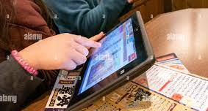
PROPOSED SYSTEM
It includes:
Automated Order Taking: Orders can be taken via a digital interface, such as tablets or kiosks.
Online Ordering: Customers can place orders online through a web application.
Integration with Other Systems: Inventory management, CRM, and analytics tools are integrated.
Enhanced Reporting and Analytics: Detailed sales reports, customer insights, and operational metrics
Improved User Experience: A more intuitive and efficient ordering process for both staff and customers.
Features and ComponentsUser Interface:
Desktop Application: Java Swing or JavaFX for the local POS system.
Efficiency: Speeds up the ordering process.Integration: Seamlessly integrates with other systems.
Data Insights: Provides valuable insights through detailed reports.

Slide 6
APPROACH TO WORK FOR PROPOSED SYSTEM
Requirement Analysis
System Design
Technology Stack Selection
4. Modular Development
5. Agile Methodology
6. Version Control
7. Testing
8. Deployment
9. Maintenance and Support
10. Documentation
11. Continuous Improvement

Slide 7
Coding Language & Database :
Java:
Advanced Java
Java Swing:
Net Beans IDE
Key Java Libraries and Technologies Used
Java AWT (Abstract Window Toolkit):
Java Swing
Java JDBC (Java Database Connectivity)
Database:
MySQL
Relational Database Management System (RDBMS)
Integration with Java

Slide 8
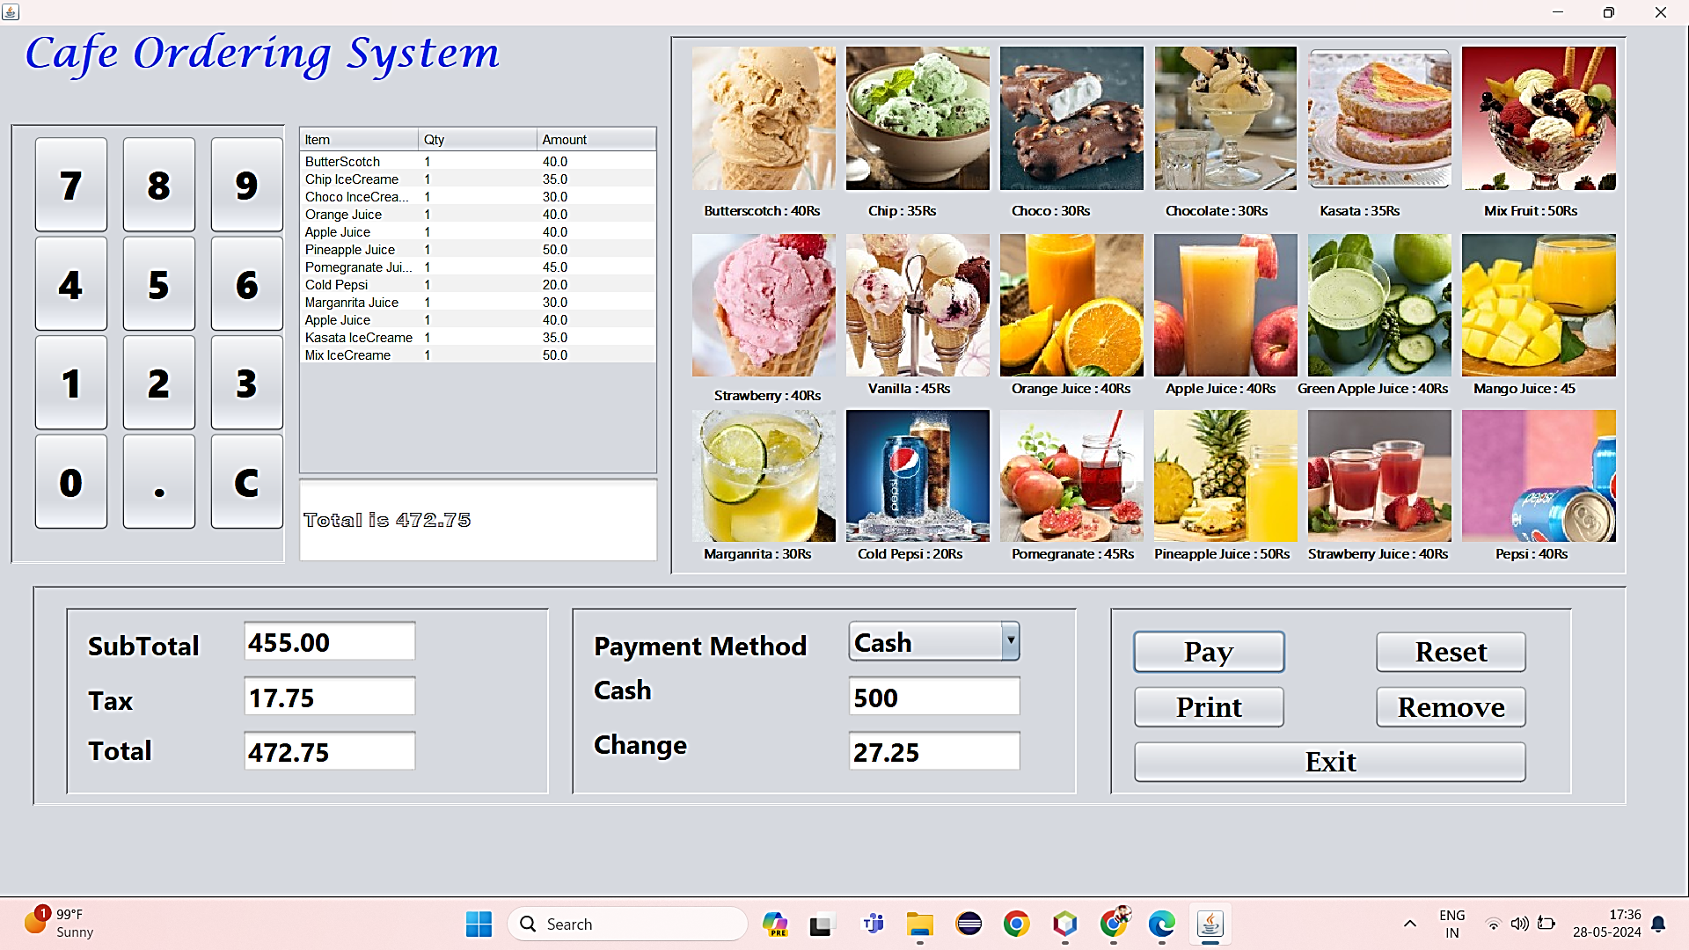
OUTPUTS

Slide 9
REFERENCES
Li, J., & Zhang, W. (2022). "AI and Machine Learning in the Cafe Industry: Future Trends and
Implications." Journal of Artificial Intelligence Research, 48(2), 190-204.
Green, P., & Thomas, S. (2023). "Sustainability in Cafe Operations: Leveraging Technology
for Environmental Impact." Sustainable Business Journal, 22(3), 234-250.
Garcia, L. (2020). "Artificial Intelligence in the Cafe Industry: Personalizing the Customer
Experience." Technology in Hospitality, 29(1), 89-103.
Johnson, R., Chen, Y., & Wang, P. (2017). "Automated Ordering Systems and Their Impact
on Cafe Efficiency." Hospitality Management Quarterly, 12(4), 301-318.
Lee, S., & Kim, H. (2018). "Customer Satisfaction in the Digital Age: The Role of Cafe Ordering
Systems." Service Industry Journal, 38(11), 872-885.
Chen, X., & Wu, Z. (2016). "Data Analytics in the Cafe Industry: Applications and Benefits.
" Journal of Business Analytics, 14(3), 213-228.

Slide 10
CONCLUSION
The Cafe Ordering System is a vital innovation for the modern cafe industry. It addresses key operational challenges, enhances the customer experience, and provides valuable insights through data analytics. By implementing this system, cafes can achieve greater efficiency, reduce costs, and ultimately build a loyal customer base, ensuring long-term success in a competitive market.

Slide 11
THANK YOU

